Slide 1
Realizing "Lifestyle Update" through Web of Things
4th June, 2019
2nd W3C Workshop on the Web of Things
Toru Kawaguchi, Takeshi Yamada

Slide 2
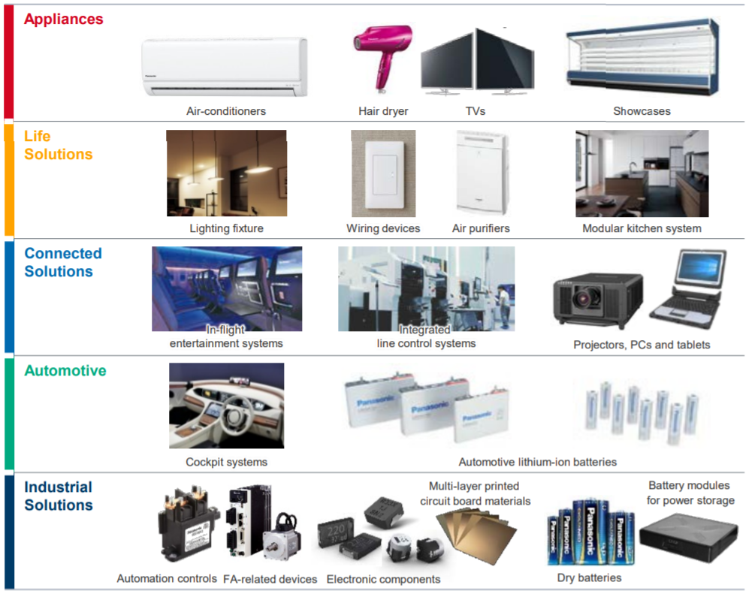
About Panasonic
Aim to be a “Lifestyle Update” company
Connected
Software defined
Upgradable
Notes:
Panasonic has been established in 1918, 101 years ago.
From that time, Panasonic has been manufacturing several products, such as Home Appliances and Equipment, devices for B2B, automotive and industrial solutions.
Panasonic now aims to be not only a manufacturer of those products, but also a “Lifestyle Update company”, by making these products into “Connected”, “Software defined” and “Upgradable”.

Slide 3
Panasonic contribution to Web of Things
Notes:
Now I’d like to look back at Panasonic contribution to Web of Things in recent years.

Slide 4
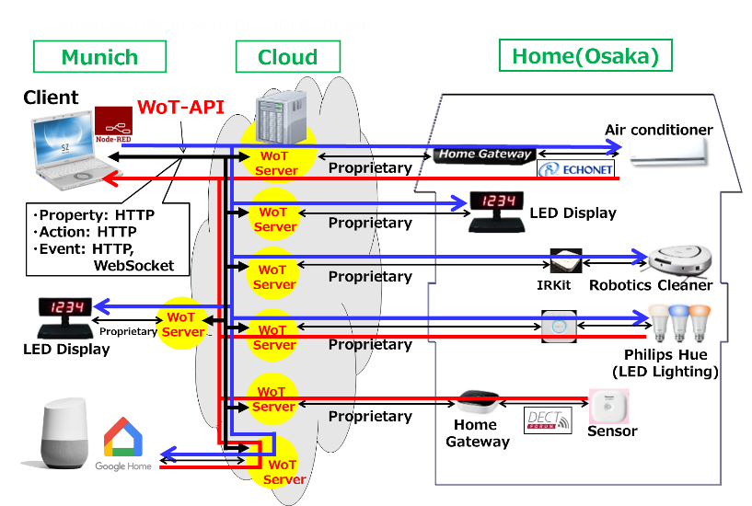
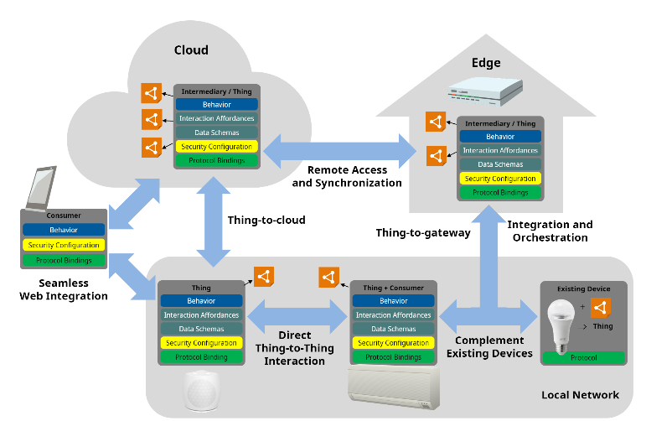
Contribution 1: Architecture supporting legacy protocols
Many devices are already connected locally
Support them in WoT abstract architecture
Notes:
First major contribution was to define architecture supporting legacy products.
This diagram shows typical implementation of our network connected products.
Some devices in home are already connected each other, by using existing protocols such as ECHONET, DECT and other proprietary ones.
These devices are connected to cloud through local gateway, and exposes REST API through cloud.
To make Web of Things ecosystem broad enough, we thought that it is important to support these existing configurations.
Therefore, we proposed to support existing devices in local network in Web of Things, and it was reflected in WoT abstract architecture.

Slide 5
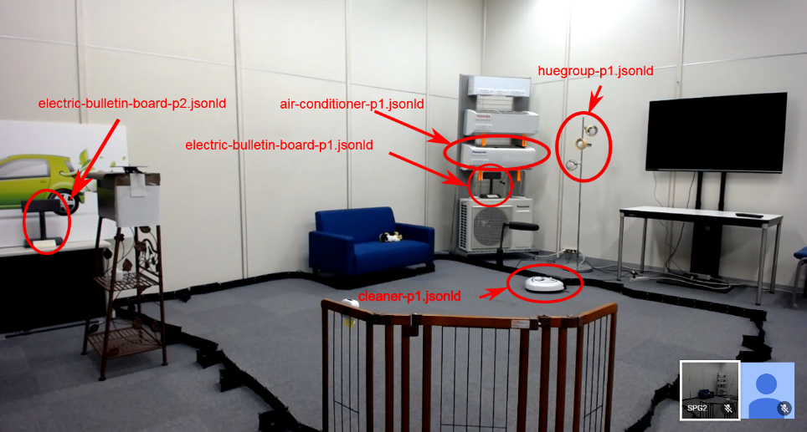
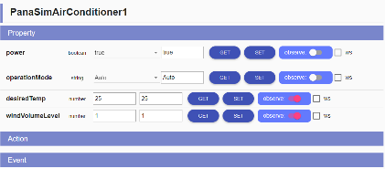
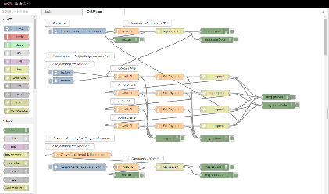
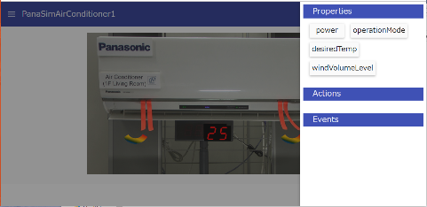
Contribution 2: Specification verification through Plugfest
Real things in Smart home
WoT Client on Browser
WoT Client on Node-RED
Virtual things (simulator)
Notes:
Second major contribution was specification verification through Plugfest.
From its early stage, Web of Things group used to perform plugfest, which tries to connects several companies’ things each other, to verify correctness of the specification which is under development.
Panasonic has been providing several components to Plugfest.
The first one is Real things in Smart Home, which is located in laboratory in Osaka and can be seen through video streaming.
Another one is Virtual things which can simulate several types of things.
We also developed WoT clients to read Thing Descriptions and access to things, utilizing both Web browser and Node-RED.
By using these components, we performed Plugfest several times and made specification correct and reliable.
It was also very effective that we could visualize what Web of Things can do.

Slide 6
Deployments in Panasonic
Notes:
Now I’d like to introduce Web of Things related deployments in Panasonic.

Slide 7




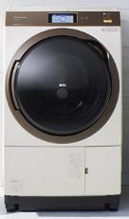


Panasonic Digital Platform
Developing APIs Based on WoT Interaction Model
Property
Panasonic User Experience Governance
Apps & Services by Panasonic
Apps & Services by Partners
“operationrStatus”
3rd Party
Panasonic Digital Platform
“temperature”
Panasonic APIs
Microservices
Living Space
Microservices
Business
Microservices
Mobility
Action
Panasonic Cloud Platform
“startRecoding”
UI AI Data/Analytics IoT Security
Event
Panasonic Products/Sensors
“washingFInished”
Notes:
Panasonic is currently constructing Panasonic Digital Platform, which will be the basis of connecting the products to cloud, and realizing “Life Style Update”.
In Panasonic Digital Platform, one of key components is Panasonic APIs, which will expose numbers of functionalities from various devices as Web API.
The Panasonic APIs are designed based on Web of Things interaction model.
For example, operationStatus and temperature of Air Conditioner are defined as Property, startRecoding of Personal Video Recorder is defined as Action, and washingFinished of Laundry Washer is defined as Event.
By aligning these APIs with standard Web of Things interaction model, we expect that application developer can easily handle these APIs and combine with other companies APIs to realize better user experience.

Slide 8
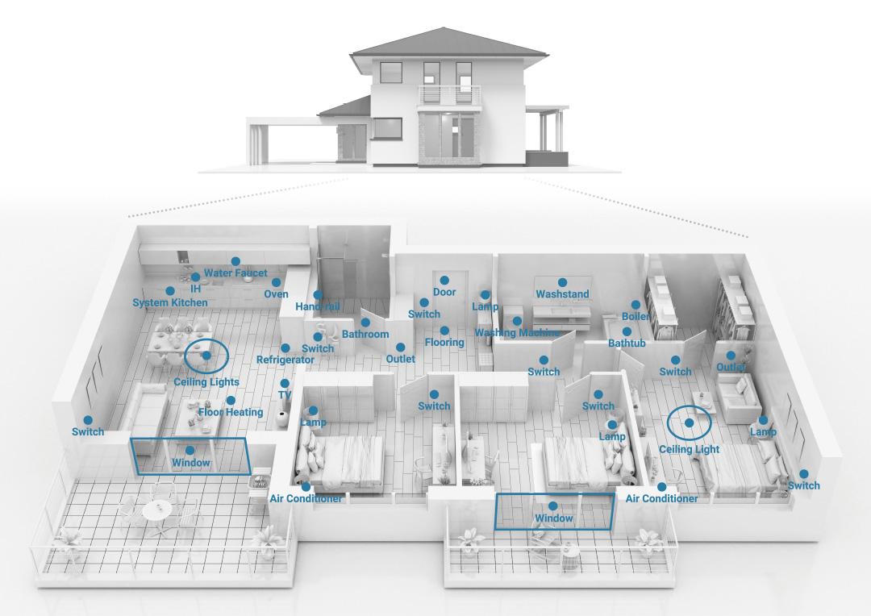

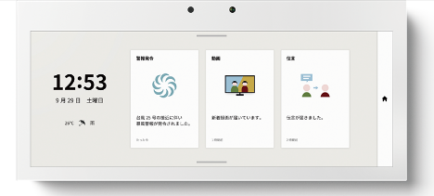
Example application: HomeX
Aim: leverage Panasonic’s touchpoints in the home
Notes:
One of example application which utilizes Panasonic Digital Platform is “HomeX”.
HomeX is the name of a concept, which aims to leverage various Panasonic’s touchpoints in the home, such as opening the refrigerator door, turning microwave oven on, and so on, to make users’ life more convenient and comfort.
In addition to existing products, we will provide new “HomeX Display”, which enables bi-directional interaction between user and home.

Slide 9
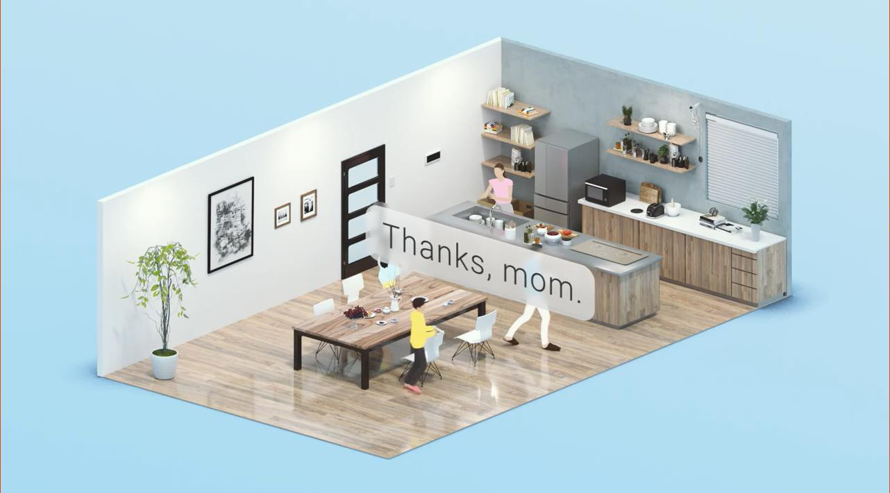
Use cases: A Life with HomeX (video)
https://www.youtube.com/watch?v=ixGUylp7VcA
Notes:
Here I show some use cases of HomeX using a few minutes video.
The first HomeX equipped house will be delivered in this autumn in Japan.

Slide 10
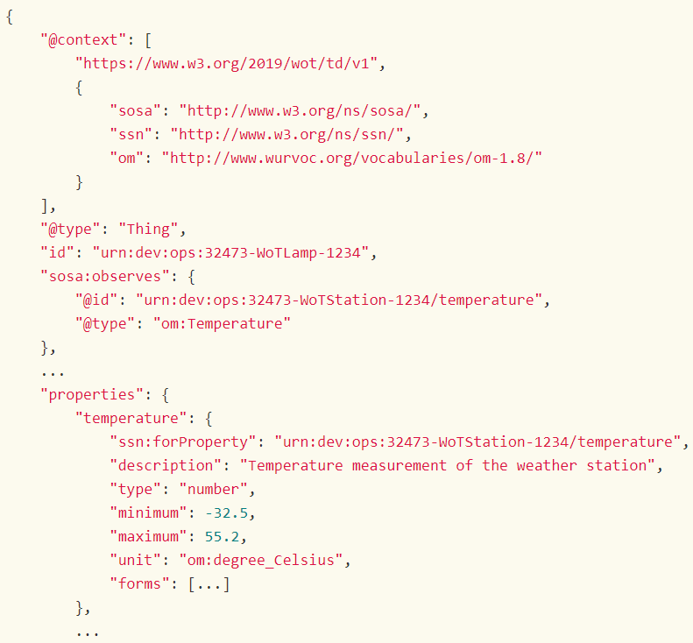
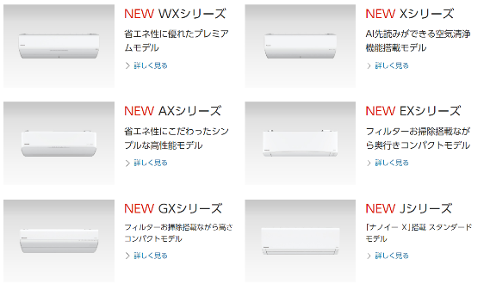


Further work on Panasonic Digital Platform
Introducing WoT Thing Description
Use case 1: Identify functionality difference among various models
Use case 2: Identify same functionality (e.g. human detection) from different devices using semantic annotation
Notes:
One of further work on Panasonic Digital Platform is introducing WoT Thing Description.
In Panasonic APIs we define multiple set of functionalities as API for each device type such as Air Conditioner and Lighting.
But actually, there are multiple models in the market for each device type.
Some model has particular functionality such as automatic filter cleaning and some model does not.
Applications need to know such difference so that it can render appropriate user interface.
To handle such use case, we are investigating use of WoT Thing Description in Panasonic Digital Platform.
Another thing we expect to Thing Description is semantic annotation to identify same functionality from different devices.
For example application such as HomeX uses many human detection sensors distributed in several types of product in home.
By using Thing Description with semantic annotation, we expect that application can easily identify human detection functionalities from multiple products in home.

Slide 11
Expectation to standardization
Notes:
Finally I’d like to explain my expectation to standardization activities

Slide 12

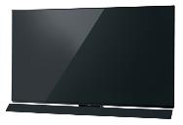




Standard set of vocabulary and data model
Further development of vocabulary and data model to increase interoperability b/w different manufacturers is expected
Home Appliances
Audio / Visual
Outside Home (next step)
Notes:
When designing Panasonic APIs, we tried to align with exiting standard as much as possible.
Therefore, we employed WoT interaction model as the basis.
To design APIs in detail, we need domain specific vocabulary and data model.
For home appliances, we employed ECHONET based vocabulary and data model, because many products in Japanese market equips it as local communication protocol.
We currently haven’t found good candidate other than home appliances, such as audio visual products and other industries outside home.
So I would applicate if you give advises whether such standards exists or not, and if not then let’s develop such standards together.

Slide 13
Thank you!

